Slide 1
My experience as an editor
Current:
Coeditor, American Journal of Health Economics, 2021-
Managing Editor, Journal of Policy Analysis and Management, 2020- Associate Editor, European Economic Review, 2021-
Past:
Editor-in-Chief, Economics of Education Review, 2014-2019
Associate Editor, Economic Inquiry, 2018-2022
Associate Editor, Journal of Population Economics, 2011- 2021
Associate Editor, IZA World of Labor, 2013-2018
Associate Editor, Economics and Human Biology, 2011-2013

Slide 2
Mark’s experience as an editor
Current:
Editorial Board, American Journal of Health Economics, 2023-
Past:
Coeditor, Economic Inquiry, 2018-2023

Slide 3
So you have referee reports…
Now what?

Slide 4

Rejection
Do not email the editor. The editor does not want or expect an email acknowledging the rejection.
Wait a few days before emailing the editor. Appeals can occasionally elicit a response and reassessment.
Some journals have a formal appeals process
Think about revising the paper. If the reports sound similar (if the same issue is raised by each and every referee), then do your very best to revise the paper.

Slide 5

Rejection
Look for easily addressed comments. There is some chance that you will draw the same referee at the next journal to which you submit.
Referees do NOT have to recuse themselves if they’ve provided comments on your paper to another journal
If your research question is narrow, there is a good chance that you will draw the same referee again and again

Slide 6

Congratulations! You have an R&R
Do not email the editor. The editor does not want or expect an email acknowledging the decision.
If you hit a roadblock in the revision process, you might consider emailing the editor. Read the decision letter carefully.
I will often explicitly invite authors to contact me if they run into a roadblock
A good editor will give you direction. She will tell you what to focus on and clearly point you to the most pressing issues.
Other editors will not give you any direction. They will likely leave the final decision to the referees. If this is the case, then you are engaging directly with the referees and the editor is, in all likelihood, going to blindly follow their recommendations.

Slide 7
To resubmit, you’ll need to do the following:
Revise your paper
Write a letter to the editor
Write point-by-point responses to the reviewer comments
Your goal when writing letter and responding to comments is to sound responsive!

Slide 8
Letter to the Editor
Dear Dr. ________,
Thank you for the opportunity to revise our paper, “Terror Attacks and Election Outcomes in Europe” (MS# 4662). In response to your comments and those of the reviewers, we have made several substantial changes to the paper:
The effects of terror attacks occurring 2-3 months before an election are now examined in Section 2.1. Reviewer 2 suggested that this analysis be included in a separate...
In response to a comment made by Reviewer 1, we restructured…
Although we could not obtain data on the number of fatalities per month, we were able to…
We now include “back-of-the-envelope” estimates of the cost to society from allowing…
Our point-by-point responses to the comments of the reviewers are below. We have bolded and italicized their comments.

Slide 9
Point-by-point responses to Reviewer 1
3. Another issue is the type of terror attacks is not documented. The effect of an Islamic terror attack is probably very different than an attack by a left-wing terrorist group, don't you think?
In response to this comment, we now include a list of all known groups that committed terror attacks shortly before a European legislative election during the period under study (online Appendix Table A3). There are more than 100 terrorist groups on this list, 13 of which can be labeled Islamic.
Making distinctions between European terrorist groups based on their political orientation on a left-right scale proved to be difficult, but we now examine effects of terror attacks perpetrated by Islamic terrorist groups versus terror attacks perpetrated by non-Islamic groups…

Slide 10
The goal is to sound responsive!
Be clear about what you were able to do (and what you couldn’t do)
Always try to do something, even if it’s not precisely what the referee is asking for

Slide 11
It is often useful to repeat or rephrase a comment. Try to put some structure on vague comments.
4. It would be useful to run the regressions over different time periods and see how well the results hold. Similarly, a south dummy might be useful, since the South had fewer hospitals and more blacks…
As attitudes, physician training and medical technology evolved, middle- and upper-class women increasingly chose to give birth in hospitals during the period under study. This trend accelerated markedly after 1920 (Wertz and Wertz 1989). In Appendix Table 5, we provide pre- and post-1920 estimates of the effect of licensing on maternal mortality.
If the state fixed effects are replaced with region dummies (i.e., an indicator for South, an indicator for Midwest, etc.), the negative association between maternal mortality and the licensing of midwives remains...
If the referee is wrong or misinformed, avoid pointing it out. Try to work around it.

Slide 12
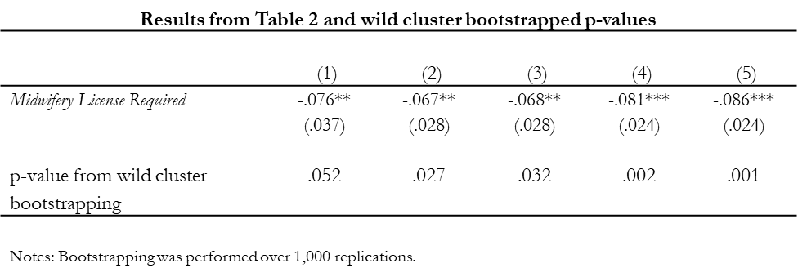
Do not make referees hunt for your new estimates. Put new and updated results in the point-by-point responses. You can put tables or figures in the point-by-point responses.
The table below reports the results from Table 2 with p-values calculated from the wild cluster bootstrap technique for comparison. In general, inference changes little when bootstrapping.

Slide 13
Referees, of course, can be negative. Often, you will disagree with a suggestion and want to avoid implementing it.
1. First, the authors should determine what the main focus of the paper is and organize the structure of the paper accordingly. On the one hand, the title and the introduction focus on suicide behaviors and not on bullying victimization or depression. The rest of the paper also seems to be changing focus from one issue to another without a clear thought process about whether the focus is on bullying victimization, suicide behaviors, depression or LGB.
The rest of the report read like a detailed guide to restructuring our paper, which we did not want to do. Because the editor was engaged, we decided to push back. Probably not a good idea if the editor is not engaged!

Slide 14
How long should you wait before resubmitting?
Major revision
Check to see if there is a deadline
Not all journals set a deadline. Editors can alter the deadline.
Medical journals have very short deadlines (≤ 1 month)
Even if there is no deadline, try to resubmit within six months
If the revision is going to take longer than a year, consider emailing the editor and letting her know
Minor revision
Check to see if there is a deadline
Even if there is no deadline, try to resubmit quickly (within a few weeks?)

Slide 15

How to write an effective
referee report

Slide 16
When should you decline a request to referee?
Do you know the author(s)?
Can you be objective?
How close is your relationship with the author?
At the JHR, being reviewed by a co-author is associated with a .096 increase in the probability of positive recommendation, or a 21% increase relative to the mean of 0.45 (Carrell et al. 2022)
Email the editor and ask for direction
Alternatively, get your report back quickly and let the editor know that you have a relationship with an author
Reference
Carrell, Scott E., David N. Figlio, and Lester R. Lusher. 2022. “Clubs and Networks in Economics Reviewing.” NBER WP No. 29631.

Slide 17
When should you decline a request to referee?
Have you refereed this manuscript before?
Email the editor and ask for direction
Alternatively, get your report back quickly and let the editor know that you’ve reviewed the paper before
Has the manuscript changed?
If authors have addressed your comments, it’s ok to recommend “accept as is.”

Slide 18
When should you decline a request to referee?
Do you have a competing working paper?
E-mail the editor and ask for direction
Alternatively, get your report back quickly and let the editor know that you have a competing paper. Carefully describe the overlap between the two papers.
Is your working paper cited?
How long has your working paper been available?
Is your working paper described accurately?

Slide 19
Your report
Begin report with a quick summary
Describe, data source, ID strategy, main findings
What is the bottom line?
Describe the importance of the contribution and shortcomings

Slide 20
Your report
Number your points
Numbering provides structure/guidance
Major comments questions, and suggestions
Minor comments, questions, and suggestions
Be constructive
Your job is not to impress the editor
Ask if you’re not certain
Try not to stargaze

Slide 21
Your report
Try to keep the report to one or two pages
If you are recommending revisions, your report will usually be longer than if you are recommending rejection
In general, 5-page reports are useless

Slide 22
Your report
You are writing with two audiences in mind
Provide enough background so that the editor can understand your major points. Remember, the editor probably has not read the paper carefully.
You’re trying to persuade the editor, not the author(s)
If you’re writing a positive report, keep in mind that another referee is almost certainly writing a negative report. Be clear about why you like the paper.
If you’re writing a negative report, try to put yourself in the author’s shoes. Be clear, but not gratuitously negative or pedantic.
Other comments, suggestions, and questions can be directed to the author(s). You can assume an intimate knowledge of the methodology and institutional details.

Slide 23
Negative but constructive
In Table 4, the authors split the sample based on the gender of the instructor. Unfortunately, they run into power issues. In columns (1) and (2) of Table 4, neither of the 𝛿 estimates is statistically significant and the estimates of 𝛾 are not distinguishable from each other in a statistical sense…
On page 18, the authors argue…, but I am skeptical given the power issues referred to above. Would it be possible to collect more data? With more data, the authors might be able to convincingly...

Slide 24
Positive and constructive
The authors identification strategy is clever and the research question is of first-order importance, although…
1. The empirical setup is standard, but instead of using an indicator (ban vs. no ban), the author uses an index that is intended to capture the strictness/intensity of the smoking ban. This index involves weighting the four different types of bans by…My preference would be to start by showing the results based on a simple ban indicator, then…

